Slide 1
Depth estimation from stereo images - Census Transform and Hamming Distance
Student: Rad Lidia
Group: 30434
Supervisior: Varga Robert

Slide 2
Introduction:
Given 2 images of the same scene, one from the right angle and the other from the left angle, create a mapping of the disparities between the pixels from two different perspectives.
Depth maps with lighter shades will indicate larger disparities and thus nearer scene elements, and darker shades, the farther scene elements.

Slide 3


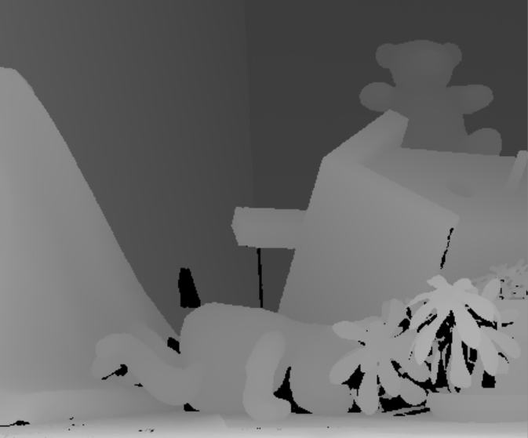
Input:
Right angle: Left angle: Ground Truth:

Slide 4
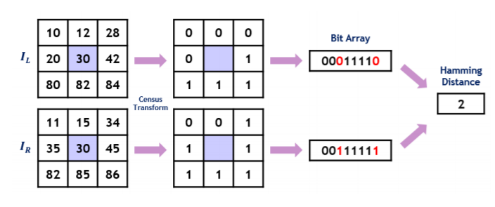
Proposed method:
The disparity map is computed using Census transform and Hamming distance.

Slide 5
Census transform:
Census transform translates relative intensity variation to 1 or 0 in one dimensional vector structure.
Using census transform every pixel within an image is transformed into a sequence of bit representing the intensity relations between the center and its neighboring pixels.

Slide 6
Census transform:
It can be divided into two steps: transform step and correlation step.
transform step - calculation of a bit string, which summarizes local texture of the current corresponding pixel pair from left and right window centre.
correlation step - comparison of two strings using the hamming distance by counting of differing bits.

Slide 7

Hamming distance:
The hamming distance is computed between census-transformed pixels by performing XOR operation between two binary strings and counting the number of set bits in the output string for finding the matching value for each pixel.
The costs are computed and stored in a three-dimensional data structure Disparity space image (DSI), with size width × height x disparity.

Slide 8
Disparity:
The hamming distance is minimized after applying the census transform to calculate the matching value by computing for each disparity the sum of hamming distances from the DSI in a window of 100.
For each pixel, the disparity with the minimum sum is chosen and stored in the disparity map.

Slide 9
Noise filtering:
Median filter is applied on disparity map obtained to remove some outliers.
This filter is popular method for removing salt-and-pepper noise from images. It is also used to remove noise generated occasionally because of sub pixel refinement.
Filtering of disparity map can increase the accuracy of output.

Slide 10
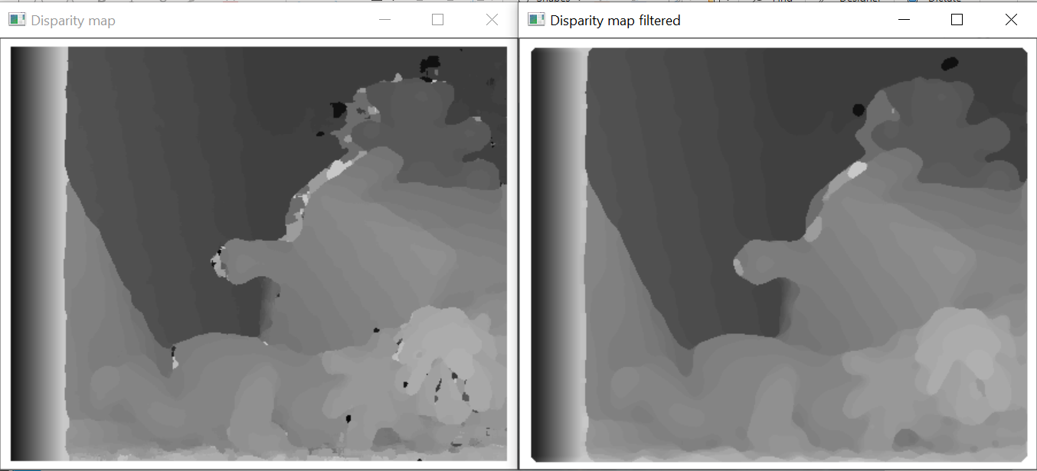

Experimental results:

Slide 11
Error calculation:
The error is computed by taking each pixel from the disparity map and the ground truth and counting the pixels that differ in intensity with more than a value set (in this case: 2) and dividing by the image sizes in order to get a percentage representing the error.
Error: ~0.32

Slide 12
Bibliography:
https://www.youtube.com/watch?v=5UKMvO5bXPI&t=137s (for hamming distance)
https://www.cs.cornell.edu/~rdz/Papers/ZW-ECCV94.pdf (the project)
https://vision.middlebury.edu/stereo/data/scenes2014/#description (examples)
https://pdfs.semanticscholar.org/1e0c/2c8535684f0b6293418e148b4f6d04829dce.pdf

